Slide 1
Damage Control Resuscitation: Why and How
Babak Sarani, MD
Associate Professor of Surgery
Director, Center for Trauma and Critical Care (CTACC)
George Washington University

Slide 2
Disclosures
None

Slide 3
Objectives
Background on hemorrhage and transfusion
Risks/Benefits of blood product transfusion
Review evidence basis for damage control resuscitation
Notes:
Transfusion practices include use of whole blood
Discuss risk/benefit of whole blood transfusion (leukocyte active!)
New treatments for coagulopathy include Factor VII, QuickClot

Slide 4
Background
Hemorrhage – 2nd leading cause of death in trauma
  1.8 million units of PRBC annually (15%)
  Trauma patients needing transfusion : 6% BUT
    33% of transfused trauma patients need massive transfusion
      ~ 50% will survive to discharge
Notes:
#1 cause of death in trauma is TBI
33% of trauma-related deaths are due to hemorrhage, one-third to half of which occur in the pre-hospital setting
Trauma pts use 15% of total RBC transfused annually in US

Slide 5
Background
Most common cause of PREVENTABLE death following injury is BLEEDING
Most important factor for survival is time to arrest of hemorrhage
Resuscitation is an adjunct. The goal is to Stop the Bleed!

Slide 6
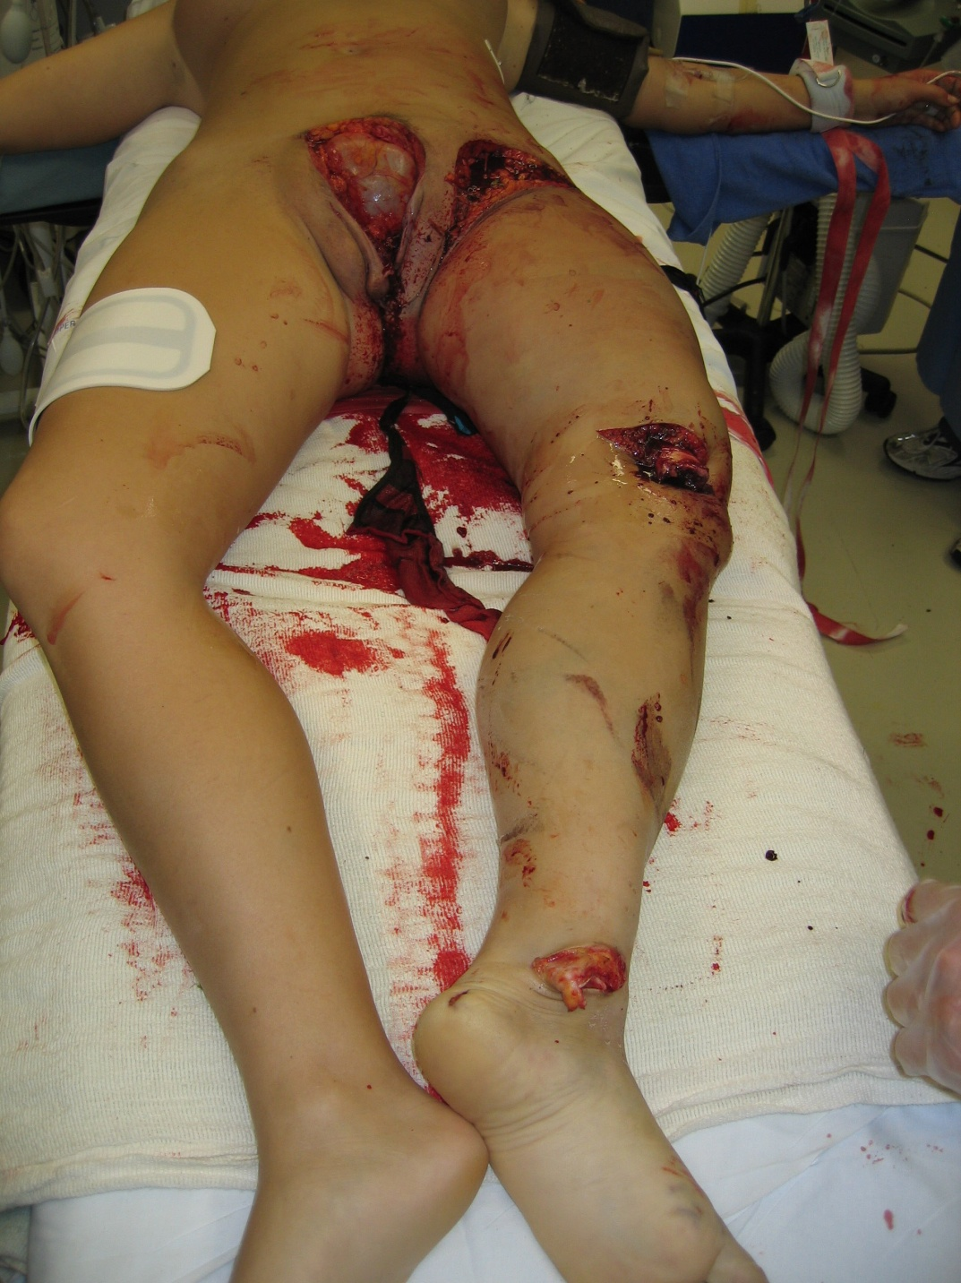


Slide 7
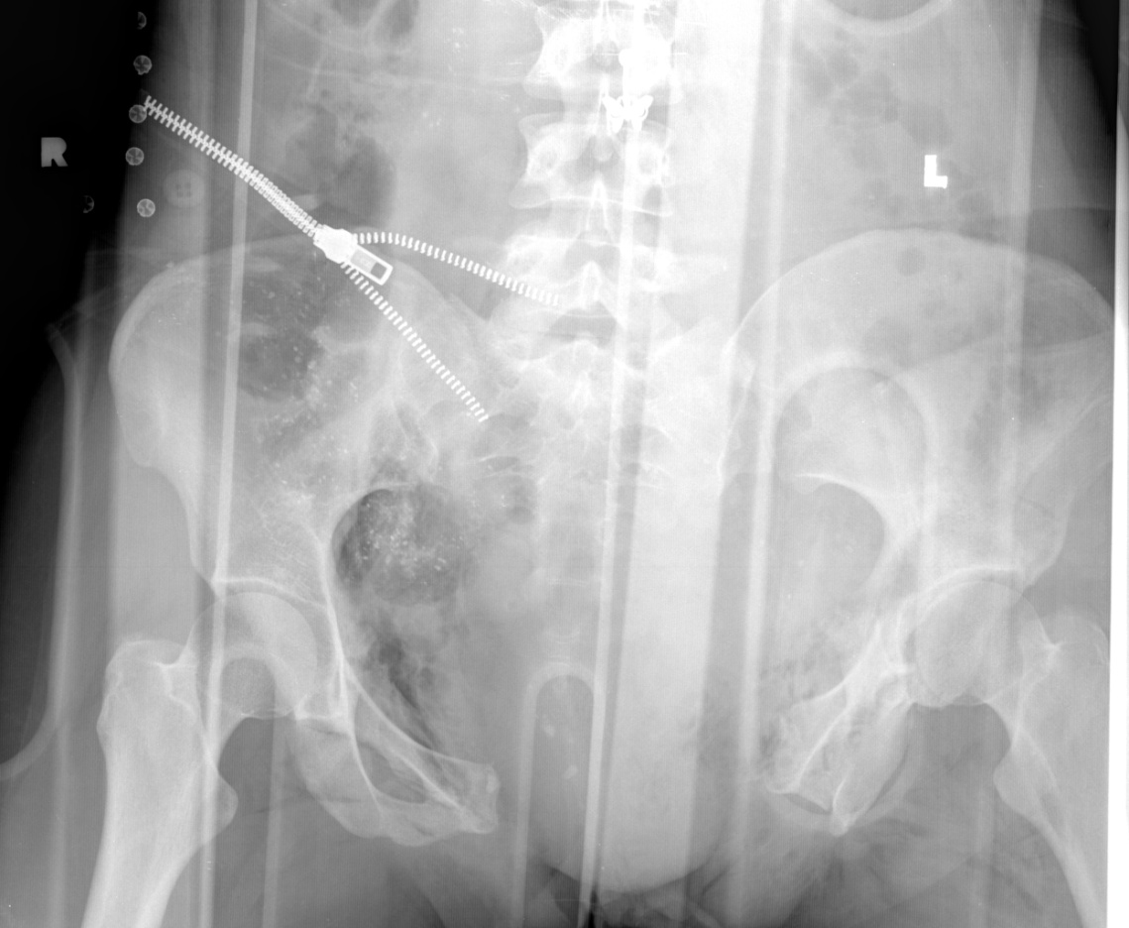
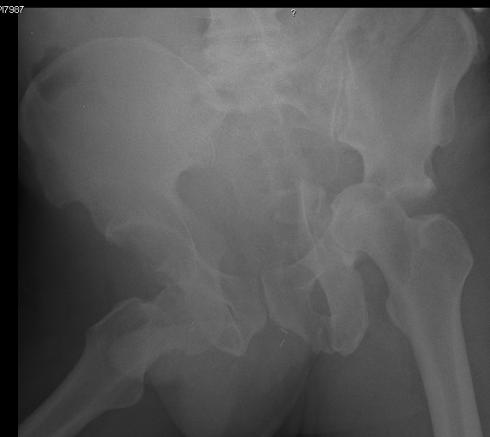
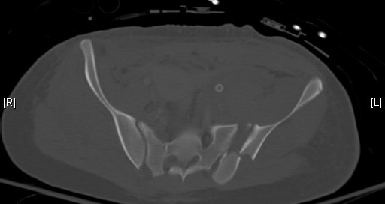
Notes:
Pt is taken to OR to examine abd, pack pelvis, Trauma Exsanguination Protocol initiated
Keep SBP 80-90

Slide 8
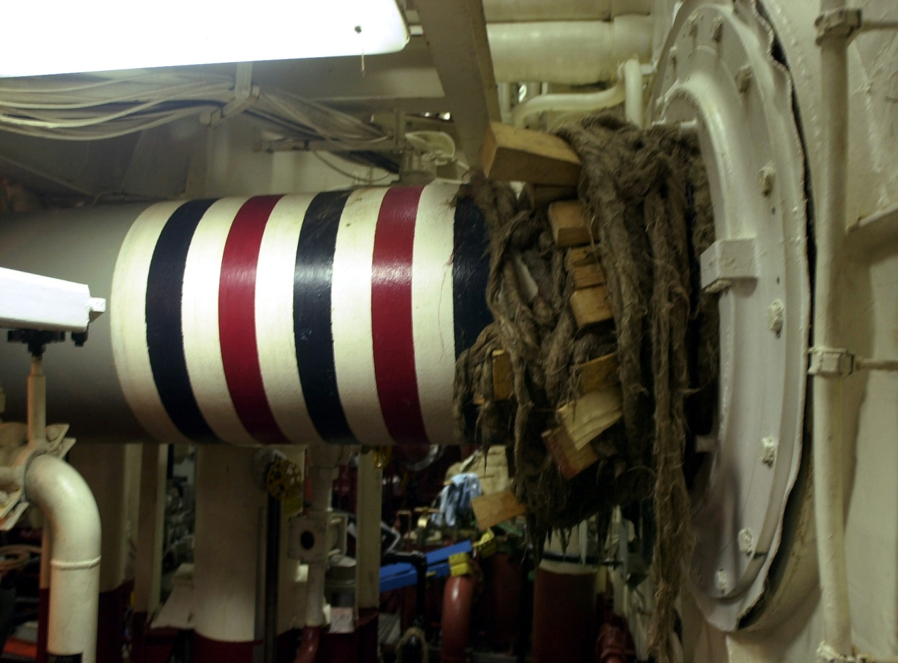
Damage Control
Wrapping and plugging of damaged
propeller shaft
Notes:
Damage control was first described by Stone in Emory in 1983. Stopped operation when coagulopathy was noted. Used packing and left bowel in discontinuity. Term coined by Schwab.

Slide 9
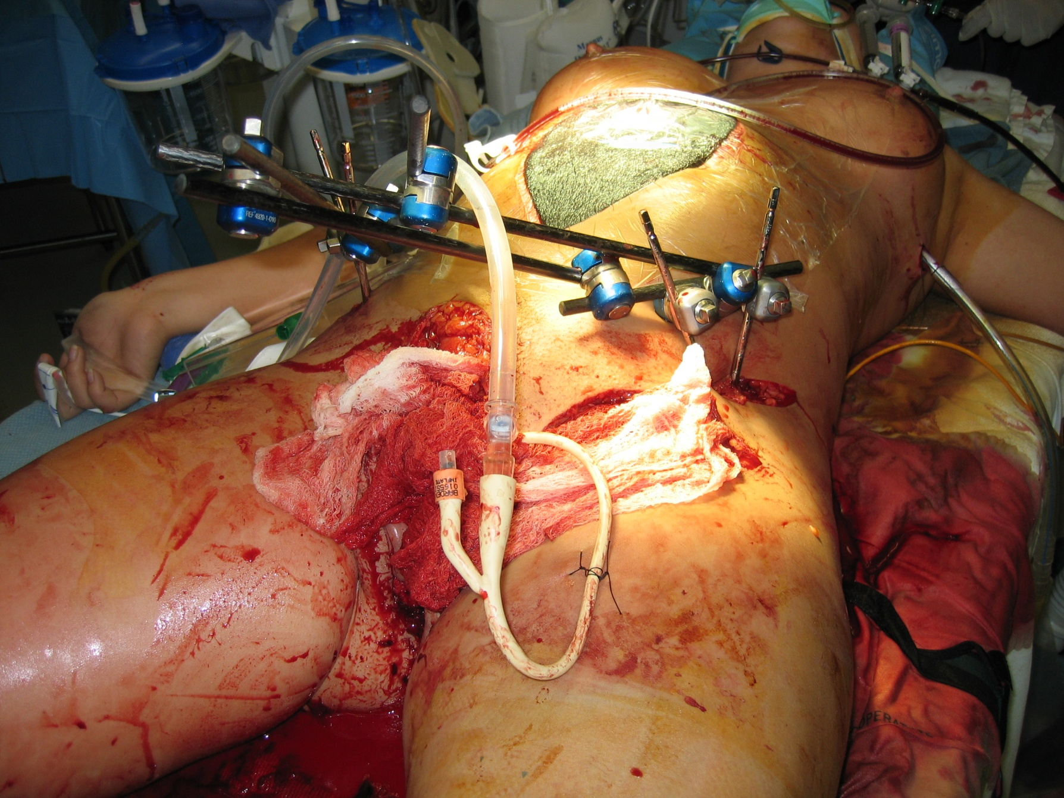
Notes:
Excessive crystalloid

Slide 10
Damage Control Resuscitation
Blood based therapy with 1:1:1
Minimize crystalloid
Consider TXA
  BP Target for Resuscitation
    SBP 80-100 mm Hg for penetrating trauma
    SBP ~120 mm Hg for TBI
    Presence of a radial pulse
    Mental status

Slide 11
Why Transfuse
O₂ delivery = cardiac output x O₂ content
  O₂ content = 1.34 x hg x SaO₂ + 0.003 x PaO₂
Volume expansion [Colloid]
Notes:
Transfused blood takes time to become biologically active (2,3 DPG). Furthermore, it may not become active (hemolysis, sludging). Therefore, in trauma decision to transfuse is made up front b/c waiting for pt to become acutely anemic risks transfusing non-active blood in hemorrhaging pt

Slide 12
Indications for RBC Transfusion
Degree of Hemorrhage (ATLS Classification)
  Class I-II: < 30% (< 1500ml)
  Class III and IV: > 30% (> 1500 ml)
Notes:
Class III and IV have are tachy > 120, hypotensive, anxious confused. Problem with this system is it does not pre-emptively transfuse and waits for sx
Resuscitating class III and IV with IVF causes further dilutional anemia and coagulopathy. These pts are coagulopathic on arrival (discuss later)

Slide 13
Indications for RBC Transfusion
Blood Pressure
  SBP < 90 mm Hg considered shock
  SBP < 110 mm Hg???

Slide 14
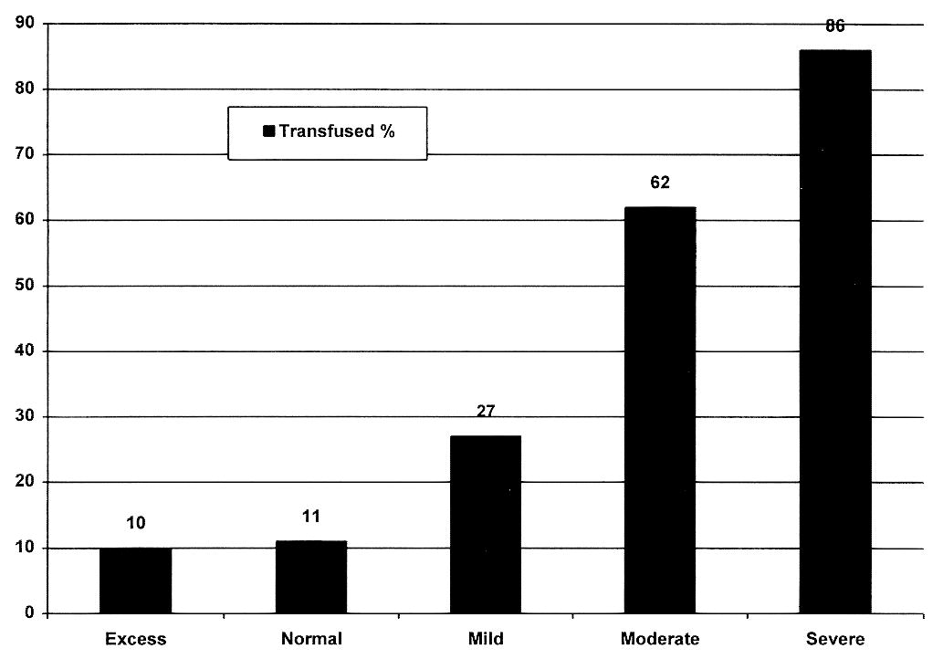
Indications for RBC Transfusion
Physiologic End-Points – base deficit
Davis, J Tr 1996; 41:769
Notes:
Other end-point is lactate – but there is no data on predictive value of lactate for transfusion, only data is for predictive value of lactate on mortality
SVO2 not shown to be predictive of need for transfusion and does not correlate with early mortality (as opposed to BD and lactate which do)

Slide 15
Indications for Transfusion
Hg 10, Hct 30%
  Rheologic value described in 1975
  Indicated for active MI/Angina
  Recommended for those at risk of bleeding (cushion)
  NOT a useful endpoint in active hemorrhage

Slide 16
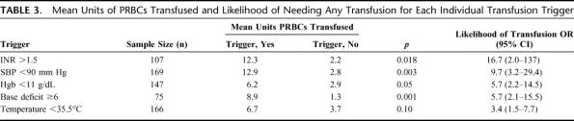
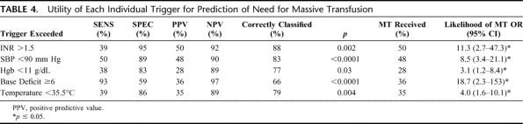
Callcut, Journal of Trauma. 70(4):794-801, April 2011.
4
Notes:
U Cincinnati. Retro study. N=170.
Coagulopathy (INR > 1.5) = need for MTP. Same w/ hypotension, BD

Slide 17
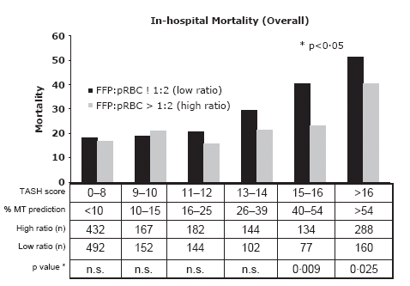
Borgman. Vox Sanguinis, 2011
Notes:
Retro study, n=2474. TASH (trauma associated severe hemorrhage) score is made up of SBP, Hg, free fluid in abdomen, long bone or pelvic fx, HR, BE, gender. May be useful way to decide early on who needs TEP. This slide shows that increasing TASH is associated with increased need for MT.
TASH > 10 is associated with a greater than 10% risk of MTP

Slide 19
Indications for Transfusion
Scoring systems to predict need
  Trauma Score < 14
    RR, resp effort, cap refill, SBP, GCS
  Injury Severity Score > 28
    Sum of the square of the three most injured regional scores
  ABC score > 2
    Penetrating MOI, positive FAST, SBP < 90, HR > 120
Notes:
Table 1: Trauma Scoring Systems
· Trauma Score: Physiologic score based on the sum of scores for respiratory rate, respiratory effort, capillary refill, systolic blood pressure, and Glasgow Coma Score. A higher value is associated with LESS severe injury severity. Maximum score is 16, minimum score is 1. 90% of pts with Trauma Score < 14 need xfusion
· Revised Trauma Score: Physiologic score based on the sum of scores for respiratory rate, systolic blood pressure, and Glasgow Coma Score. A higher value is associated with LESS severe injury. Maximum score is 12, minimum score is 0.
Injury Severity Score: Anatomic score based on the square of the sum of the three most injured regions: general, head/neck, chest, abdomen, extremity and pelvis. Each region can have a score of 1-5, with 5 being life threatening injury. A higher value is associated with MORE severe injury. Maximum score is 75, minimum score is 0.
ISS > 28 requires > 10 units of RBC
ABC score: (assessment of blood consumption): penetrating MOI, positive FAST, SBP < 90, HR > 120

Slide 20
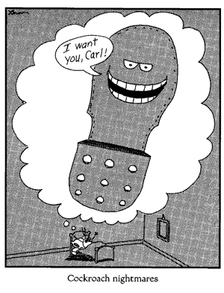
Notes:
Now we will discuss the possible downsides of transfusion and why we should not transfuse to “make ourselves feel better” or “because he is old”

Slide 21
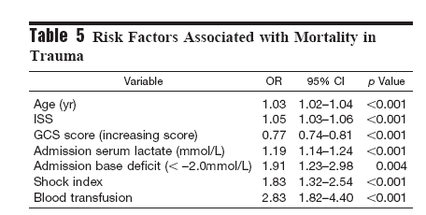
N=15,000
2003; 54:898
Notes:
3 year, trauma registry study, 15,000 pts
Transfused pts were older, penetrating trauma, higher ISS, lower GCS
Multivariate regression analysis controlling for ISS, GCS, age, race, lactate, base deficit, shock index
Dose response: Pt’s requiring > 10 U RBC had OR 3 for death relative to pts who required < 3 U RBC
Excludes pts who died in first 24 hours
14% death in xfused pts vs 9% death in non-transfused pts who survived > 24 hours after admission
Conclusion: Need blood substitute

Slide 22
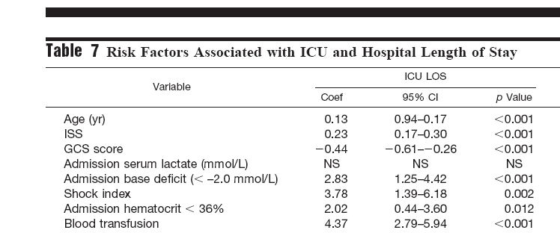
J Trauma 2003; 54:898

Slide 23
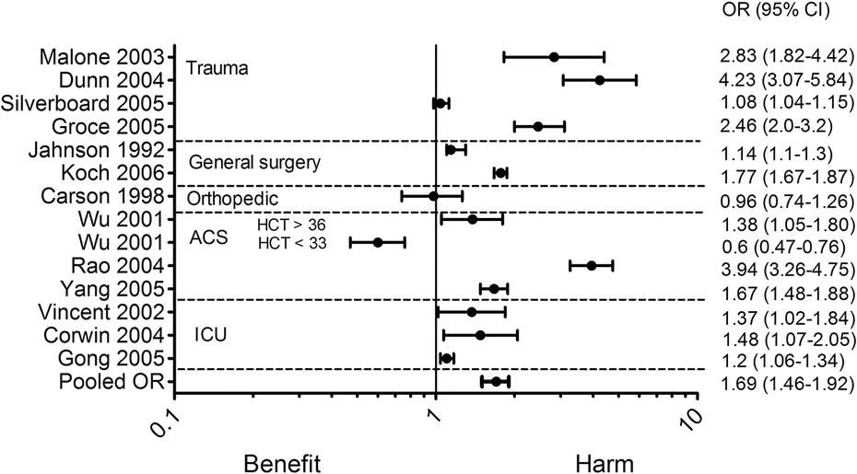
PRBC and Mortality
Crit Care Med 2008; 36 (9)

Slide 24
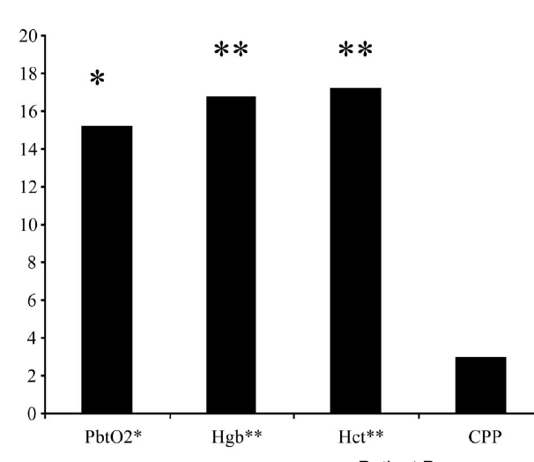
CCM 2005; 33: 1104
Notes:
75% of pts had increase PBO2 (15%) BUT 25% of pts had DECREASE PbO2. There is a subset of TBI pts who will do worse with xfusion
35 pts, prospective observational study

Slide 25
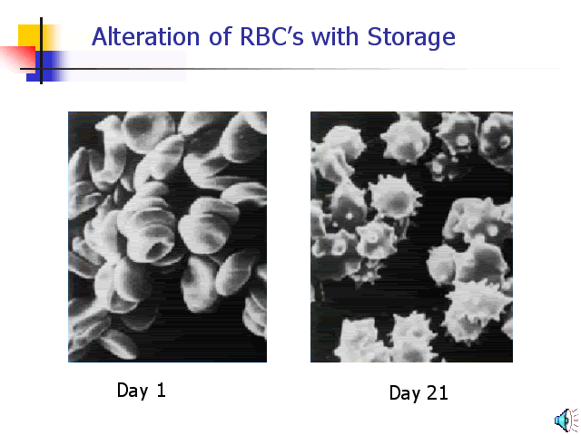
Sludging
Notes:
Blood is 7 microns and cap is 3 microns
Depletion of ATP, oxidation of spectrin

Slide 26
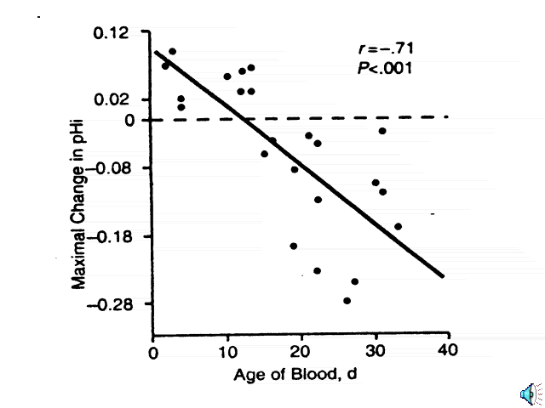
Sludging
Marik, JAMA 1993; 269:3024
Notes:
Expect O2 delivery to increase w RBC transfusion but it may actually cause end organ ischemia
Septic pts receiving 3 units of RBC each. Measurement is gastric tonometry
Subsequent study using sublingual capnography in humans did not validate these findings
Another mechanism may involve liberation of hemoglobin from lysed RBC and scavenging of NO with resultant arteriole spasm

Slide 27
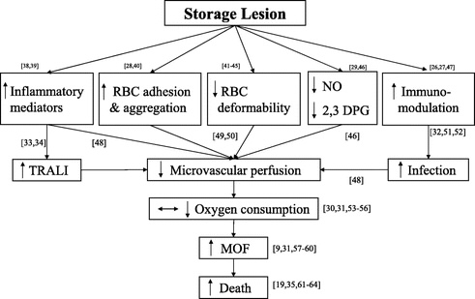
Biological Impact of RBC Storage
Crit Care Med 2007; 35 : 2576

Slide 28
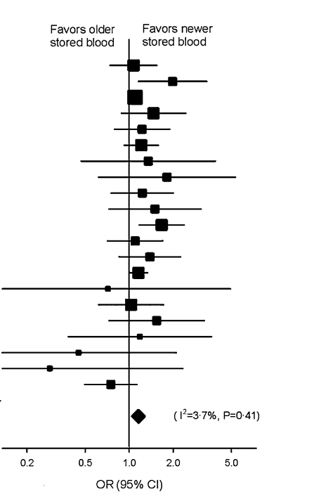
Age of Blood and Mortality
Wang et al. Transfusion. 2012; 52:1184-96

Slide 29
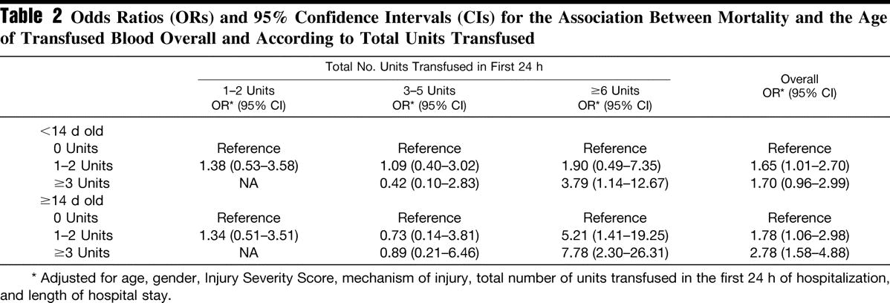
Age of RBC and Mortality in Massive Transfusion
J Trauma 2008; 65 : 279
Notes:
Retro, 2000-2007, U Alabama. N=1813
Age of RBC appears to have negative mortality impact when more than 5 units of blood are transfused. Transfusion of fresh blood in massive transfusion is also assoc with death, but the risk is increased when old blood is used

Slide 30
Mechanisms to Explain Detrimental Effects of Transfusion
Transfusion Related Acute Lung Injury (TRALI)
Transfusion Associated Volume Overload (TACO)
Transfusion Related Immunomodulation (TRIM)
Notes:
Common theme between TRALI and TRIM: Transfusion of foreign proteins cause inflammatory reaction and altered immune function
Not going to discuss TACO but rather we will spend time on TRALI and TRIM and sludging

Slide 31
TRALI
Non-cardiogenic pulm edema within 4 hours of transfusion
Incidence 1:10,000 – 1:100,000
Confounded in setting of pre-existing lung injury/ARDS/Contusion
Inflammatory reaction to transfused protein/antigen – highest risk with FFP
Notes:
Highest risk with FFP due to large protein load (foreign antigen)

Slide 32
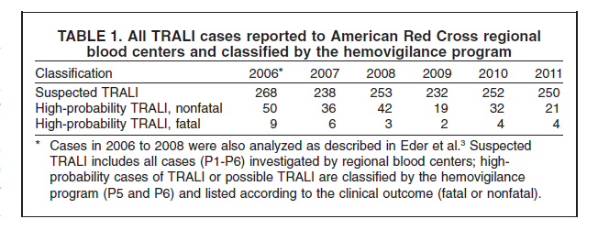
TRALI
Eder et al. Transfusion doi: 10.1111/j.1537-2995.2012.03935.x
Notes:
After 2006, the Red Cross started using predominantly male or nulliparous female FFP. The exception to this is AB FFP which is rare. This table shows that the incidence of FFP assoc TRALI has decreased a lot despite significant increase in FFP transfusion. The only exception to this is AB FFP which is essentially unchanged due to ongoing female contribution
TRALI rate went from 18.6/million unit of FFP in 2006 to 4.2/million units of FFP in 2011. AB risk did not change with TRALI OR of 14.5.

Slide 33
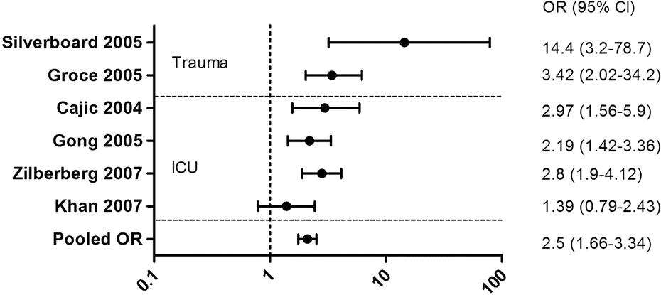
PRBC and ARDS
Crit Care Med 2008; 36 (9)

Slide 34
TRIM
2003; 54:908

Slide 35
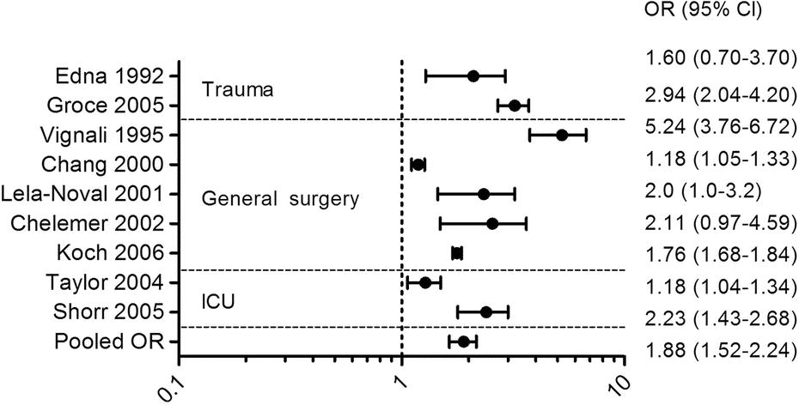
Infection and PRBC
Crit Care Med 2008; 36 (9)

Slide 36
Am Surg 2006; 72: 619
Notes:
Combat registry review, 210 pts, 7 week time course
44% transfused, 88% penetrating trauma
Multivariate regression confirmed transfusion as risk for infection and ICU admission and ICU LOS. Did NOT find assoc with mortality
Conclusion: Need blood substitute and hemostatic agents

Slide 37
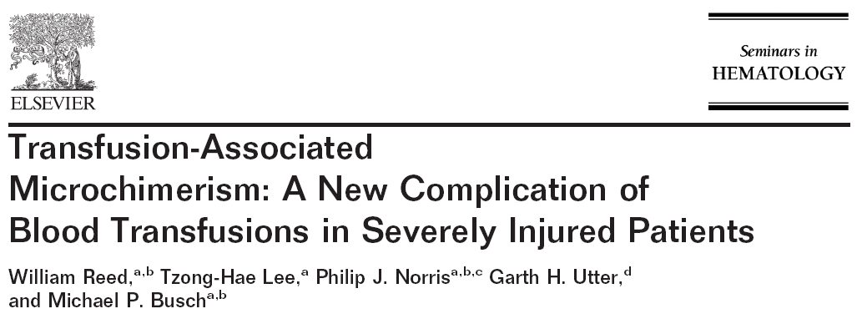
2007; 44: 24
Notes:
Fig A: Elective pts undergoing Gyn surgery. The donor leukocytes are cleared after 7 days
Fig B: Trauma pts. The donor leukocytes last years
Foreign DNA can be found in 50% of transfused pts at discharge. The foreign DNA load INCREASES in over years and can form 5% of the total WBC load in 10% of pts. This is in pts receiving leukodepleted blood. May be beneficial for transplant pts but points to immunosuppression in trauma pts
Microchimerism has NOT been shown in medical pts receiving PRBC. There is something different about trauma pts – tissue destruction, etc? Altered immune system?
Does this matter? Future autoimmune disorder, graft v host,

Slide 38
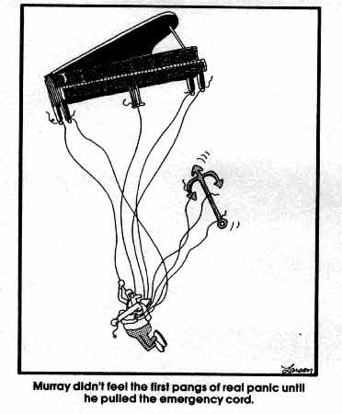
Reality Check
Notes:
Having discussed the indications, benefits, and liabilities associated with transfusion, let’s discuss how to go about resuscitating the massively bleeding pt

Slide 39
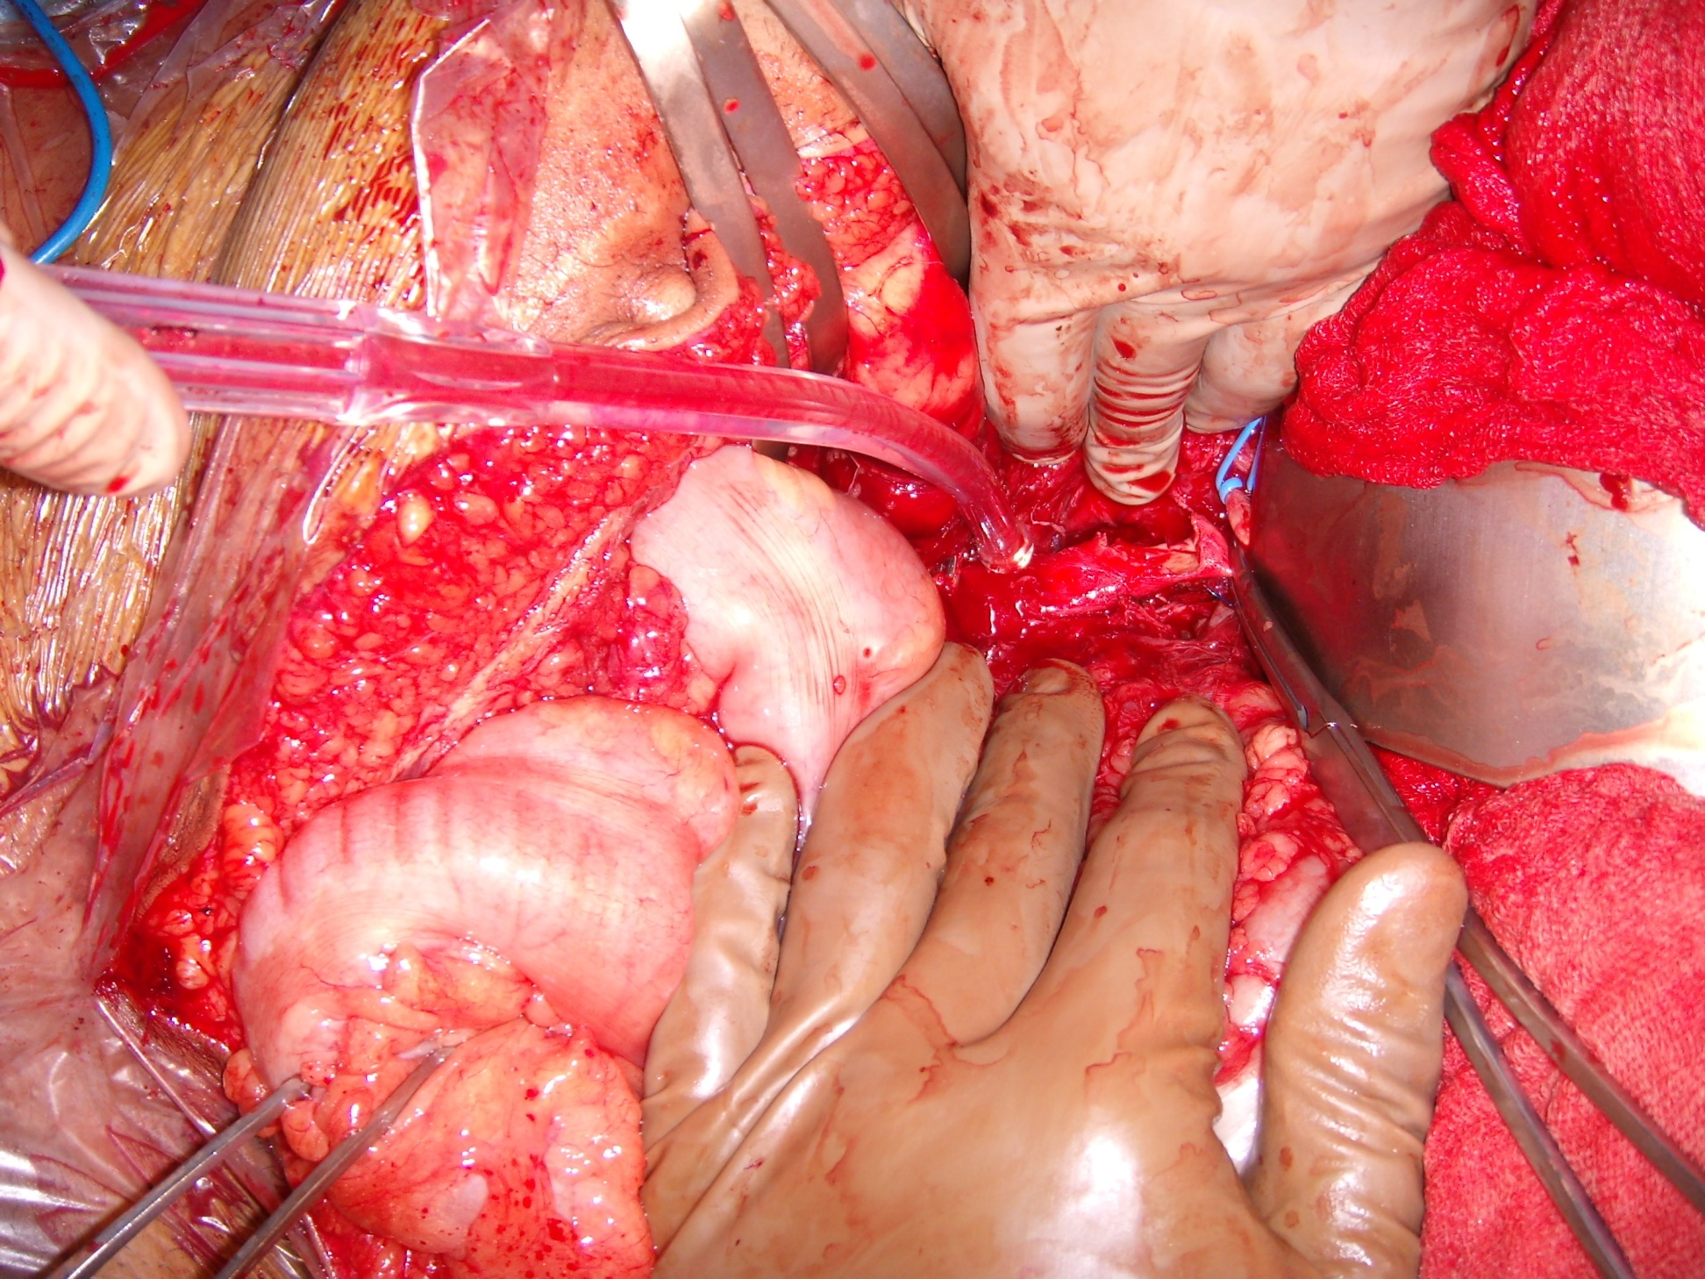

Notes:
GSW Aorta. Repaired with pTFE initially, replaced with homograft in coming days. Sigmoid resection but left colon died. Formal L hemicolectomy and stoma. Ultimately, homograft was infected, suture line blew out and pt exsanguinated in ICU. Vascular did not think ax-fem would be useful due to young age and risk of thrombosis

Slide 40
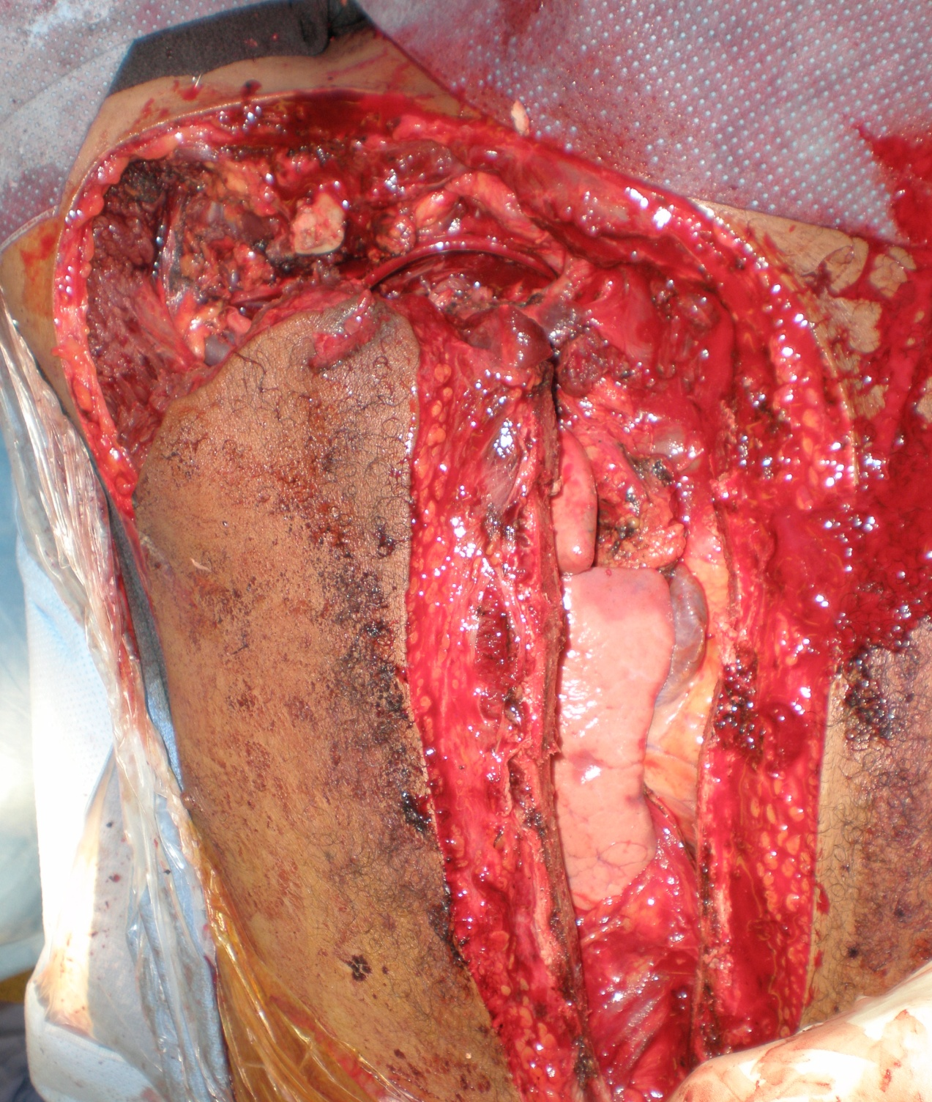

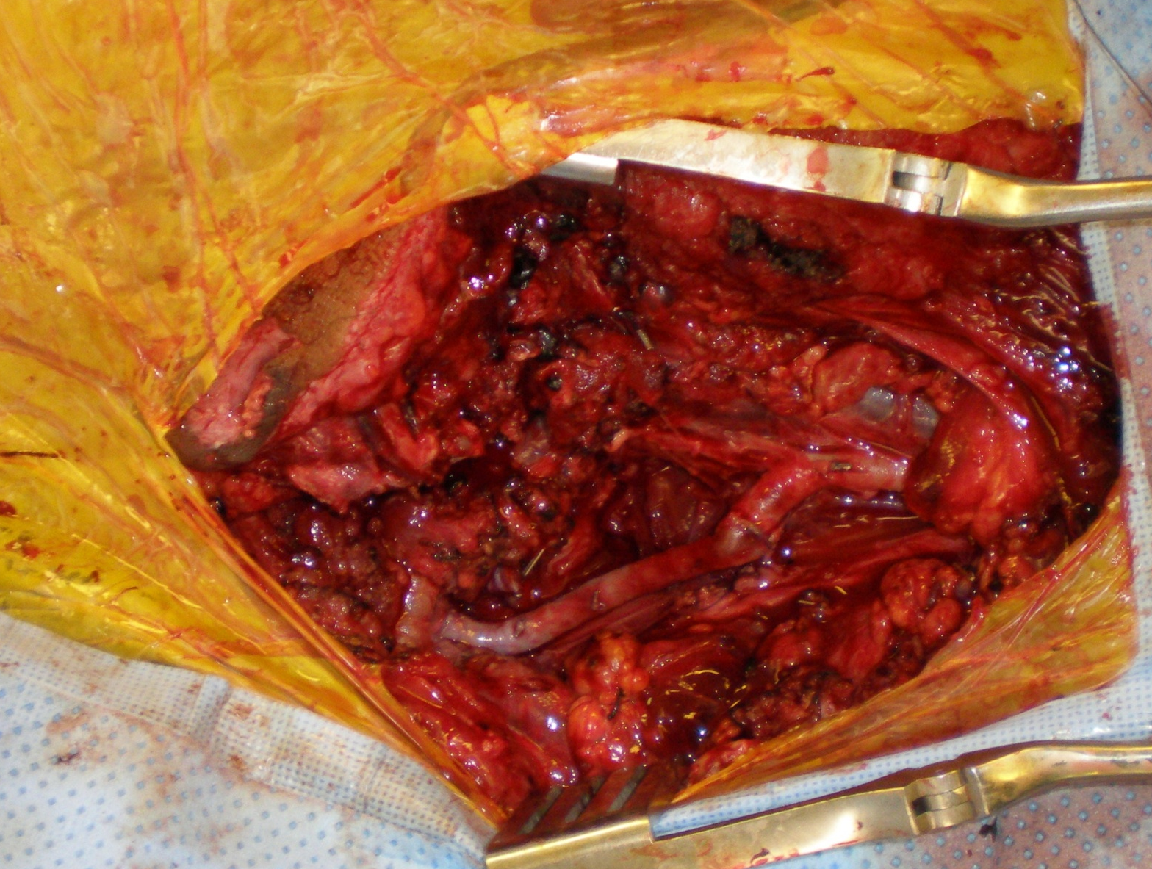
Notes:
GSW right subclavian artery. Initially shunted then SVG repair

Slide 41
Resuscitating the Bleeding Patient
Lethal Triad of Trauma
  Hypothermia < 34
  Acidosis < 7.1
  Coagulopathy > 2
98% Mortality (w/o damage control)
Notes:
All severely injured pts are coagulopathic on arrival. Whereas we are good at preventing hypothermia and treating acidosis, we fail to correct coagulopathy until too late (miliatry data)
Ph < 7.1, T < 34, SBP < 70, and ISS > 25 confer 98% chance of severe coagulopathy

Slide 42
Resuscitating the Bleeding Patient
Trauma Bay/ICU/ED
  In-line blood warmers and rapid infusers
    Rapid infusion may dislodge clot*
  End point for transfusion
    SBP 80-100 mm Hg for penetrating trauma
    SBP ~120 mm Hg for TBI
*Hambly PR, Dutton RP 1996; 31(2):127-33.
Notes:
A rapid infusion, in-line blood warmer system should be used in all instances where patients are being emergently transfused with non-reconstituted PRBC to prevent worsening hypothermia from administration of a large volume of cold blood.

Slide 43
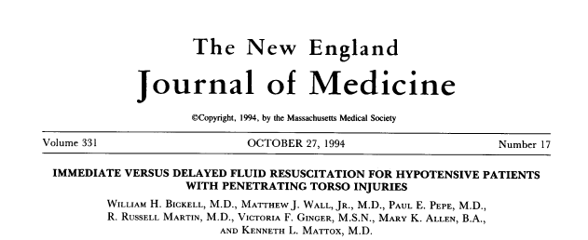

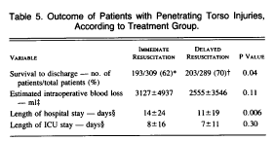
Notes:
N=600, penetrating torso trauma, SBP < 90.

Slide 44
Resuscitating the Bleeding Patient
Operative and Interventional Radiology Resources, GI/endoscopy, etc…
Exsanguination Protocol
Aggressive treatment of coagulopathy
  FFP, Platelets, Factor VII, TXA

Slide 45
“Prolongation of the PT is the sentinel event…and occurs early in the operation”
J Trauma 2003
Notes:
25-50% of severely injured CIVILIAN pts are coagulopathic on arrival to hospital (Brohi 2003)
Our current language of massive transfusion does not take into acct coagulopathy – we define massive transfusion as > 10u RBC in 24 hours and FFP is a second thought

Slide 46
2007; 62:112
Notes:
Probability of death increases in coagulopathic pt. Due to increased need for RBC? Ongoing shock? Loss of factors (both bleeding and consumption) Unknown….
N=97, 51 months, prospective, observational
Causes of coag: blood loss, hemodilution, consumption, hypothermia, acidosis, fibrinolysis

Slide 47
Addressing Coagulopathy
1:1:1 resuscitation?
  Military reports
  Minimize cystalloid
  Start platelet transfusion after 7-10 units of RBC
Factor VII?
Notes:
Coagulopathy is frequently viewed as an inevitable consequence of hemodilution and massive bleeding, but recent reports from the military in Iraq suggest that this view is erroneous and that most severely injured patients arrive at the care facility coagulopathic (Holcomb J Trauma 2007)

Slide 48
1:1 FFP to RBC
FFP : RBC N=246 | Overall Mortality | Hemorrhagic death
Low (1:8) | 65% | 93%
Medium (1:2.5) | 34% | 78%
High (1:1.4) | 19% | 37%
Borgman. J Trauma 63 : 805, 2007
Notes:
N=246, all received massive transfusion > 10U RBC, equal ISS and MOI. Overall mortality 28%
High group also received cryoppt – other groups did not
High group required net less IVF and RBC transfusion also – stopped coagulopathy due to dilution and bleeding?

Slide 49
1:1 FFP to RBC
Variable | Odd Ratio (95% CI) | p value
FFP : RBC ratio | 8.6 (2.1-35) | 0.003
AIS head/neck | 0.76 (0.61-0.94) | 0.013
AIS Thorax | 0.73 (0.57-0.92) | 0.009
Base Deficit | 0.89 (0.84-0.95) | < 0.001
Borgman. J Trauma 63 : 805, 2007
Notes:
Narrowing FFP:RBC assoc with improved survival
Worsening AIS and BD assoc with decreasing survival

Slide 50
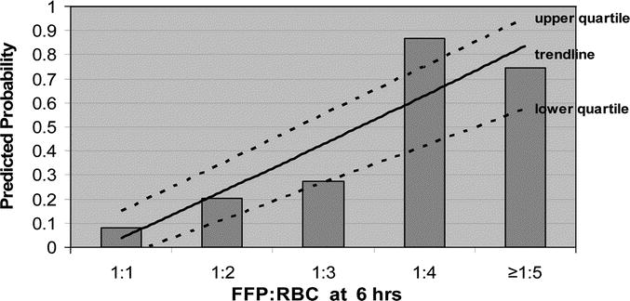
1:1 Civilian Experience - Coagulopathy
Kashuk, J. J Trauma 2008; 65 : 261
Notes:
Denver. Retro. N=133. Goal: assess impact of FFP:RBC ratio on outcome from 2001-2006
Predicted probability of coagulopathy (defined as INR > 1.5) on arrival to ICU
Blunt and penetrating injury

Slide 51
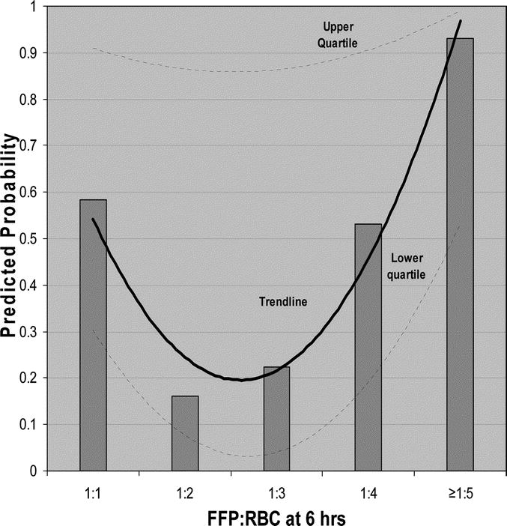
1:1 Civilian Experience - Mortality
Kashuk, J
J Trauma 2008; 65 : 261
Notes:
Denver. Retro. N=133. Goal: assess impact of FFP:RBC ratio on outcome from 2001-2006
Includes blunt injury only (this graph).
Graph shows predicted probability of death. Suggests 1:2 is best. Other studies suggest that slightly less than 1:1 is better also

Slide 52
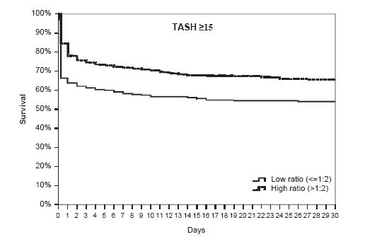
Borgman. Vox Sanguinis, 2011
Notes:
Retro study, n=2474. TASH score is made up of SBP, Hg, free fluid in abdomen, long bone or pelvic fx, HR, BE, gender. May be useful way to decide early on who needs TEP. This slide shows that early and appropriate (TESH >15) use of TEP reduces mortality.

Slide 53
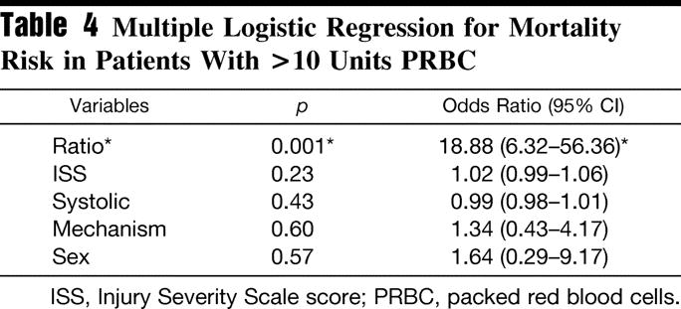
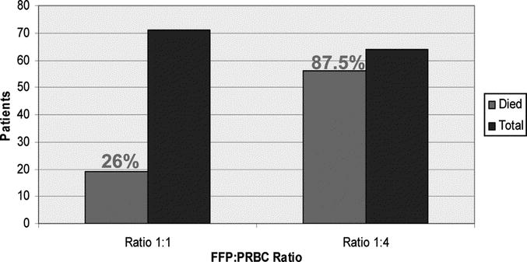
1:1 Civilian Experience - Mortality
J Trauma 2008; 65 : 272
Notes:
Retro, 4 yrs, N=135
Tulane

Slide 54
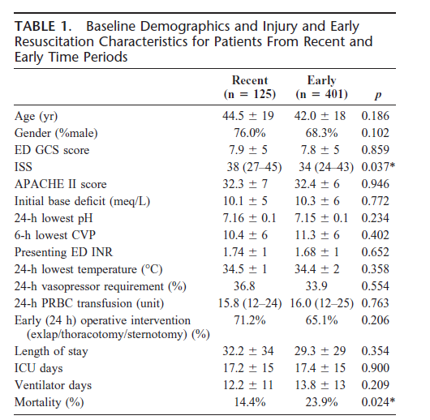
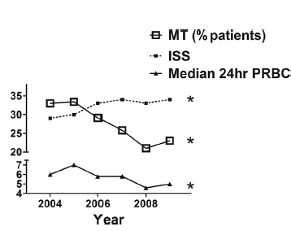
Transfusions Trends over Time
Notes:
Retro multicenter study (glue grant) comparing 2004-2007 (pre high dose FFP) and 2007-2009 (post high dose FFP)
N=1961 with 526 requiring MT and 344 requiring 5-10 units of RBC (sub-MT).
In the early period, ISS has risen but mortality has gone down. Over time, we see that overall RBC transfusion need and need for MTP have decreased despite increase in ISS

Slide 55
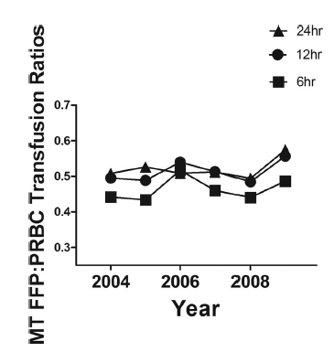
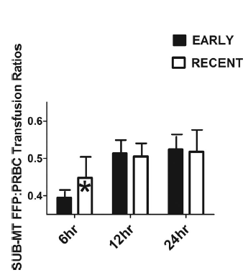
Transfusions Trends over Time
Kautza J Trauma 72(1):106-111; 2012
Notes:
Graph on left is MTP only. No change over time
Graph on right is sub-MTP (5-10 units of RBC in first 24 hours). There has been a significant increase in the early transfusion of FFP.
Paper has similar graphs for RBC:PLT
Overall, this study shows that early aggressive use of FFP seems to decrease the overall need for RBC transfusion and is associated with improved survival. However, pts who are destined for MTP are unchanged.

Slide 56
Is it FFP or is it lack of Crystalloid?
Time Bias to survival
Retro study of 572 pts over 6 yrs
High FFP | Standard Tx
5 L IVF | 14 L IVF
7 U RBC | 13 U RBC
8 FFP | 11 FFP
0 Plt | 6 Plt
Cotton B Ann Surg 254(4):598-605; 2011
Notes:
Damage Control Resuscitation Reduces Resuscitation Volumes And Improves Survival In 390 Damage Control Laparotomy Patients
Bryan A Cotton, MD*, Neeti Reddy, MD*, Quinton M Hatch, MD*, Eric LeFebvre, MD*, Charles E Wade, MD*, Rosemary A Kozar, MD, Brijesh S Gill, MD*, Rondel Albarado, MD*, Michelle K McNutt, MD*, John B Holcomb, MD
Study compares pre-damage control resuscitation with post. Similar demographics, ISS, MOI, admission VS, labs. Significantly higher survival at 24 hour and 30 days which persisted on MVR (OR 2.5)

Slide 57
Resuscitation
Swell ≠ Get Well
  ARDS
  Compartment Syndrome
  Prolonged mechanical ventilation
  Prolonged ICU LOS
  Ileus
  Anastomotic Dehiscence and fistulae

Slide 58
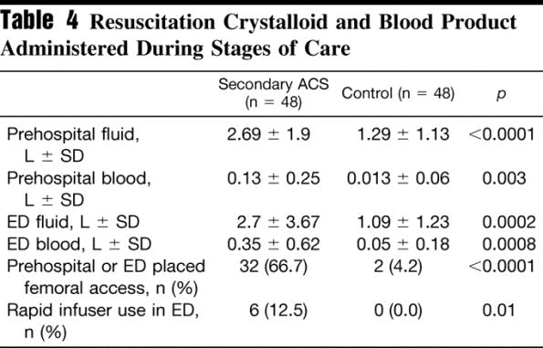
Over-Resuscitation
Abdominal Compartment Syndrome
  96 Severely injured patients
Madigan. J Trauma 2008;64(2):280-5
Notes:
Retro study comparing 48 pts who developed secondary ACS with 48 who did not

Slide 60
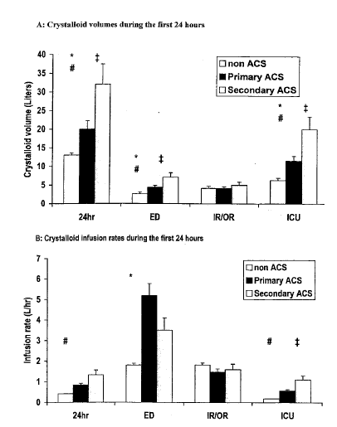
N=188 over 44 months
Balogh. J Trauma. 2003;54:848-861
Notes:
Trauma pts, N=188 in 44 months.
No difference in demographics in primary and secondary ACS.

Slide 61
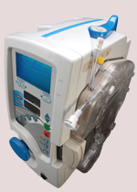
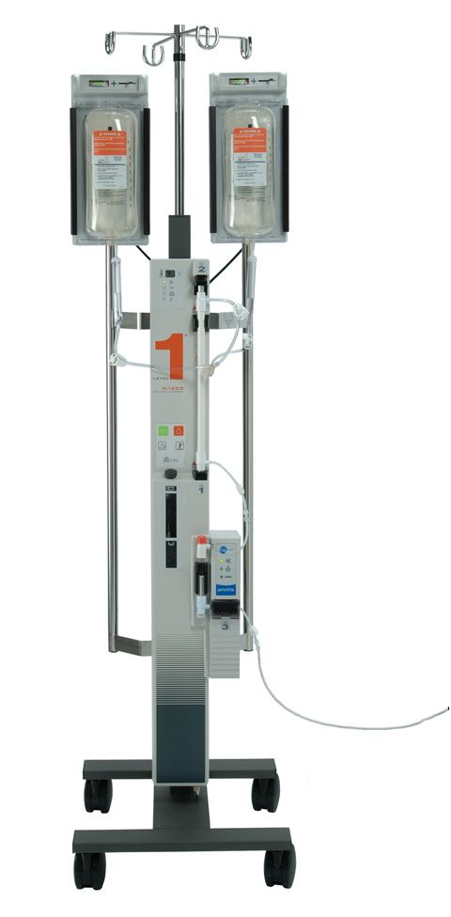
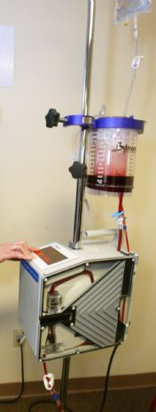
Rapid Infusers
Characteristics:
  Portable
  Heater
  Variable Flow
  Ease of use
  Can infuse 1:1
  Cheap
Thermacor 1200
Level I
Belmont

Slide 62
Rapid Infusers

Slide 63
Rapid Infuser Comparison
Attribute | Thermacor | Belmont | Level I
Portable | X | X
Mix PRBC and FFP | X | X
Rapid Infusion on Battery Power | X
Titratable Rate of Infusion (Precision) | X | +/- (cannot bolus)
Auto-Purge Air | X
Ease of Set Up and Use (no extra personnel needed) | X | +/- (need to monitor infusion rate on rapid mode)
Cheap |  |  | X
Heater | X | X | X

Slide 64
Massive Transfusion Protocol at GW
Round 1:
  RBC x 4
  FFP x 2 (PRE-THAWED)
Subsequent Rounds:
  RBC x 6
  FFP x 6
  Plt
Factor VII/TXA (physician discretion)
MINIMIZE CRYSTALLOID USE
Notes:
Convert the blood bank from a “pull” to a “push” mentality
Need a protocol b/c massive transfusion is rare (~2% of all pts [.33 x 6%])

Slide 65
Stored Plasma Factor Levels
Day 5
Factor VIII 60%*
Factor II 99%
Factor V 84%
Factor VII 80%
Factor X 94%
Fibrinogen 100%
Transfusion 2001 * p<0.05

Slide 66
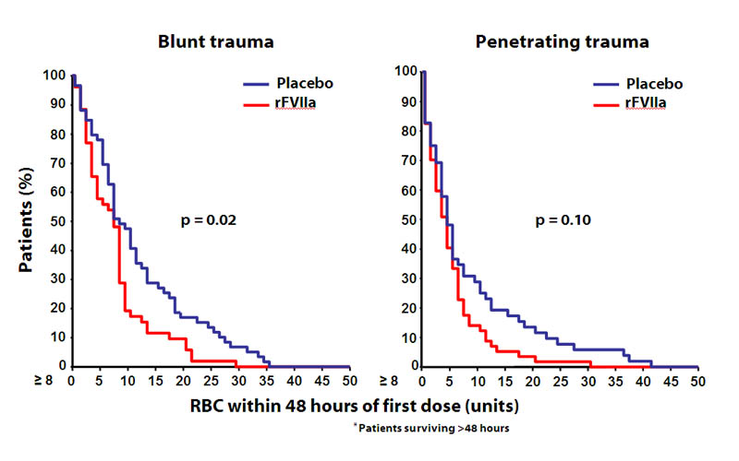
Factor VII in Trauma
Boffard. J Trauma 59 : 8-15, 2005
Notes:
Factor VII first used in Israel in 1999 (high velocity GSW). First used in US in 2002 for pt with mult stabs who had received > 100 units of RBC. Pt stopped bleeding. Israel case: GSW to the cava. Ligated cava. Received 5 liters of PRBC, 3 liters of FFP. Stopped bleeding after 2 doses.
Recombinant Factor VIIa works by binding to exposed tissue factor in an area of endothelial injury, thereby activating platelets and forming a platelet plug. It then stimulates the coagulation cascade by activating thrombin on the platelet plug. Fibrinolysis is inhibited through Factor VIIa-mediated activation of thrombin-activatable fibrinolysis inhibitor.

Slide 67
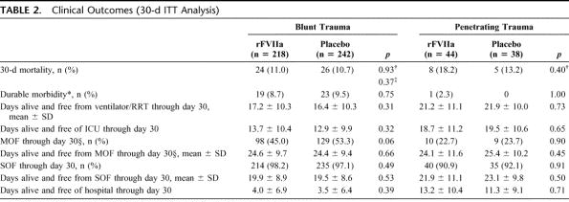
CONTROL Trial: Efficacy and Safety of Recombinant Activated Factor VII in the Management of Refractory Traumatic Hemorrhage.
TABLE 2.
Journal of Trauma. 69(3):489-500, September 2010.
2
Notes:
Multinational RCT, placebo controlled, double-blinded. Stopped early for futility
Include: injury < 12 hours old, pts received 4-8 units of RBC prior to randomization, 18-70 yo
Dose: 200 mcg/kg x 1 then 100 mcg/kg x 2. Much higher than usual doses used
Problems: powered for 30% mortality (n=1276) but actually had 11% mortality (n needed >3000 pts). Key interventions protocol controlled based on EBM (transfusion, damage control, VTED therapy, vent wean, etc). Perhaps the observed mortality was low due to EBM approach to care. Drug dose given higher than what is usually used
As opposed to the previous Boffard trial, this study used intention to treat and also found a decrease in blood transfusion need, but the difference between groups was only 1-2 units per pt
This slide shows no difference in mortality
Conclusion: Factor VII does not change mortality and does not give a clinically relevant decrease in blood use. However, the study was underpowered and is prone to Type II error

Slide 68
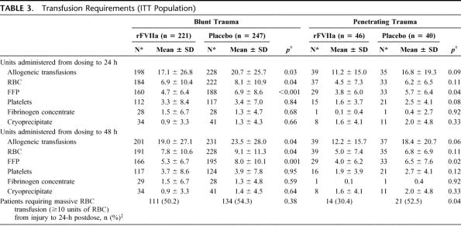
CONTROL Trial: Efficacy and Safety of Recombinant Activated Factor VII in the Management of Refractory Traumatic Hemorrhage.
TABLE 3.
Journal of Trauma. 69(3):489-500, September 2010.
3
Notes:
Slide shows blood salvaging impact of factor VII but the difference in blood use is very small between groups

Slide 69
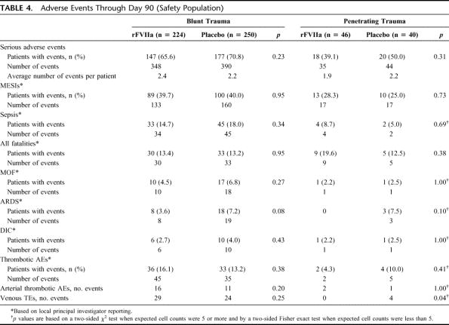
CONTROL Trial
TABLE 4.
4
Notes:
No difference in complications, including VTED

Slide 70
Factor VII in Trauma
Futile if:
  pH < 7.1
  Platelet < 50,000 cells/microliter
  PT > 17.6 seconds
  Lactate > 13 mmol/L
  RTS < 4
J Trauma 2005; 59: 609
J Trauma 2004; 57: 709

Slide 71
Factor VII – Non Traumatic Hemorrhage
Effective for esophageal variceal bleed
  Need 800 mcg/kg over 30 hours – cost prohibitive
Not effective for intracranial bleed (RCT)
Effective for post-partum hemorrhage
  Especially with eclampsia and HELLP syndrome

Slide 72
Factor VII
Variable dosing
  90 micrograms/kg
  40 micrograms/kg
$20,000 direct cost
Half-life 2.5 hours

Slide 73
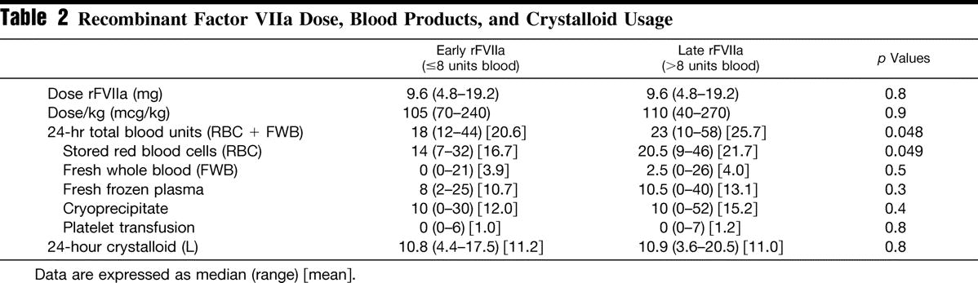
Factor VII - Timing
N=17
N=44
J Trauma 2007; 62 : 1095-1101
Notes:
Retrospective review of Iraq experience 2004-2005. N = 61. 17 pts received VII early, 44 received it late. No difference in outcome or complications. Baseline coagulopathy, temp, base deficit, age, injury pattern were similar in both groups.

Slide 74
Factor VII
FDA reports: 8% risk of MI, CVA, PE when used off-label (0.02% when used on-label)
  Age > 55, known atherosclerotic disease
  Equal incidence of arterial/venous thrombi
JAMA 2006

Slide 75
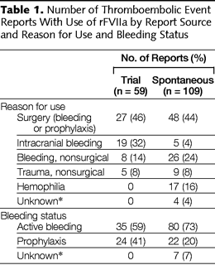
Number of Thromboembolic Event Reports With Use of rFVIIa by Reason for Use
O’Connell, K. A. et al. JAMA 2006;295:293-298
Notes:
Table 1. Number of Thromboembolic Event Reports With Use of rFVIIa by Report Source and Reason for Use and Bleeding Status

Slide 76

Time from Factor VII Dose to Thrombus Formation (Adverse Event)
O’Connell, K. A. et al. JAMA 2006;295:293-298
Notes:
Figure 5. Number of Reports by Time From Last Recombinant Human Coagulation Factor VIIa Dose to Thromboembolic Event

Slide 77
Tranexamic Acid (TXA)
Lysine derivative
  Inhibits fibrinolysis by inhibiting plasminogen
Review of 53 studies (n=3836)
  Elective surgery
  Blood transfusion need decreased 39%

Slide 78
CRASH-2 Trial on TXA
RCT, 270 hospitals, 40 countries
N=20,211
INCLUSION:
  At risk for or actual severe hemorrhage
  SBP < 90 or HR > 110
  Within 8 hours of injury
Lancet 2010; 376:23-32
Notes:
Placebo controlled. 1 gm TXA over 10 min and 1 gm over 8 hrs v placebo. This opens the possibility of survival bias – the TXA group lived long enough to get the entire TXA load and therefore was destined to live relative to placebo.
EFIC Study. Countries were from all around the world but NOT US. Included: Mexico, India, Europe, UK, Egypt, Peru, Africa, etc
Primary Endpoint: Death within 4 weeks
Secondary Endpoints: Vascular occlusive events, need for operation to control hemorrhage, transfusion need

Slide 79

CRASH-2 Trial Results
Lancet 2010; 376:23-32
Notes:
Significant decrease in death from any cause and also hemorrhage related death. There was, however, no difference in the need for transfusion overall or in any subgroup. Additionally, there was no difference in the quantity of blood needed in either group. There was also no difference in vascular occlusive events.
Only 17 pts received Factor VII total.

Slide 80
CRASH-2 Trial Results
MORTALITY FROM HEMORRHAGE
Time | TXA | Placebo
< 1 hr from injury | 5.3% | 7.7%
1-3 hr from injury | 4.8% | 6.1%
3-8 hr from injury | 4.4% | 3.1%
Lancet 2011; 377:1096-1101
Notes:
Subgroup analysis of the crash-2 data looking at time to death from bleeding found that mortality increased if TXA was given 3 hours or more after injury. Since most hemorrhage related death occurs early, this drug should be used soon after injury

Slide 81
MATTERs Trial
Morrison et al.
Arch Surg. 2012; 14(7):113-9
Notes:
900 pts total, 300 received TXA. Afghanistan combat

Slide 82
MATTERs Trial
Morrison et al.
Arch Surg. 2012; 14(7):113-9

Slide 83
MATTERs II Trial
Morrison et al JAMA Surg. 2013; 148(3):218-225

Slide 84
Fluid Type??
Isotonic (saline, LR, plasmasol, etc)
Hypertonic (3%, 7%, 23%)
Synthetic colloid (Hextend)
Blood/Plasma

Slide 85
Hypertonic Saline
Potent intravascular volume expander
Anti-inflammatory
No difference in mortality in 3 prehospital RCTs
  Increases SBP significantly (risk of recurrent bleeding?)
  Increases serum Na significantly but transiently

Slide 86
Synthetic Colloids
Starches and gelatins:
  Tend to stay intravascular for a longer time than crystalloids
  Results in osmotic gradient that moves fluid into the intravascular space
    1 part colloids ≈ 3 parts crystalloid

Slide 87

Synthetic Colloids for Initial Resuscitation
J Am Coll Surg 2010; 210:870-882
Notes:
Retrospective study of saline +/- Hextend in a single level 1 trauma center. HET limited to 500-1000cc total within 2 hours of arrival at surgeon discretion.
N=1714: 805 got HET, 909 did not. No difference in outcome on MVR

Slide 88
Morbidity With Prolonged Use
A retrospective study of trauma patients (N=2225), 22% (N=497) of whom received HES 450/0.7 as part of their fluid resuscitation regimen found increased risk of acute kidney injury (RR 1.73) and increased mortality (RR 1.84).

Slide 89
FDA Warning
Significant risk of renal failure and death noted in patients with sepsis
  Required large volumes
Black Box Warning:
  Do not use in critically ill adults (ALL of them!)
  Do not use in patients with renal dysfunction
  Do not use if patients undergoing cardiac surgery
  Do not use in patients with liver disease
  Renal side effects can occur up to 90 days following administration
Notes:
The black box warning was due to possible excessive use in the ICU over many days. Does not apply to prehospital trauma

Slide 90
CRASH-3 Trial
Currently underway
Focuses on TBI. Target N=10,000
  GCS < 12 or large intracranial bleed AND
  NO extra-cranial hemorrhage
Notes:
Same study design as CRASH 2 but focuses on GCS < 12, lg cranial bleed on CT scan, and NO significant external bleeding

Slide 91
Massive Transfusion - Outcomes
ICU Arrival Labs
88-91 97-00
ICU PT 19.6 15.2*
ICU PTT 70.4 36.8*
ICU Temp 33.2 35.3*
J Trauma 2001 *p < 0.05

Slide 92

Notes:
Lawnmower man

Slide 93

Notes:
Lawnmower man

Slide 94




Topical Agents
WOUNDSTAT
Notes:
Mineral which dessicates tissues of water thereby concentrating plasma factors and causing local hypercoagulable state. Used by Marines in Iraq. Approved for external use only. We are using 3rd generation product.
Made by Z-Medica
Other product is HemeCon used by Army in Iraq. This is a shrimp shell extract with procoagulant properties. Middle picture is a ribbon on hemcon called ChitoFlex for packing into wound tracks
Woundstat is a mix of 2 polymers that are very absorbent. Absorb blood quickly to form a cast and seal off vessel – tested in 1 study only, femoral artery puncture model

Slide 95
Topical Agents
Characteristics:
  Stop large arterial vessel bleeding < 3 minutes
  No need to mix/reconstitute
  Light weight
  Long/indefinite shelf life in extreme setting
  Safe/no infectious concerns
  Inexpensive

Slide 96


Comparison of Various Topical Hemostatics
Kozen et al. Acad Emerg Med 2008; 15: 74-81
Notes:
58 pigs, complete transection of the femoral artery with 3 minute bleed and then application of agent. 5 minute pressure. All pts received 500cc 6% hespan. Monitored until death or 180 minutes following injury.

Slide 97


Liver Injury Model
Inaba. J Trauma. 2011; 71(5):1312-18
Notes:
Porcine model, grade 4 liver with left hepatic vein transection, temp 35. 2 minutes bleeding followed by agent application and 10 minute pressure. Then liver was packed again and abdomen closed. Relook at 48 hours.

Slide 98

Celox: Heparinized Porcine Model
Not published
Notes:
Data not published

Slide 99

QuikClot
J Trauma 2004; 57 : 555-562
Notes:
Swine model with grade 5 liver injury. This was first generation and the temperature rise problem has been fixed

Slide 100
WoundStat v Others
J Trauma 63 (2) : 276, 2007

Slide 101

Animal Studies
Kheirabadi et al. J Trauma 2009; 66:316-328
Notes:
Pigs, 45 second free bleed and then agent applied to femoral artery. IVF to keep MAP 65. Kept alive until 180 minutes.
WS=woundstat, SQR=super quick relief, CX=celox, QC=quikclot, HC=hemecon.

Slide 102

In Vitro Effects of Topical Agents on Coagulation
Kheirabadi et al. J Trauma 2009; 66:316-328
Notes:
Quikclot, chitosan and hemecon either worsened coagulation or had no effect. Woundstat, SQR and celite restored coagulation. Of course, these substances are not given IV so the relevance of this remains unknown

Slide 103
Whole Blood Transfusion
Whole blood transfusion first used in US Civil War
  Accepted as standard therapy WWI
  2,000 units of whole blood sent to Europe DAILY during WWII
Component therapy started 1960’s

Slide 104
Whole Blood Transfusion
Pro
  Physiologically active
  No anticoagulants (citrate, etc)
  Hct 35-40% versus 30%
  Platelet 200,000-300,000 cells/dl versus 60,000
  Coagulation activity 85% versus 65%
  May result in net LESS transfusion need and thus lower infectious risk
Notes:
Transfusion reaction is extremely rare in massive exsanguination/transfusion – probably due to immune dysfunction/suppression
Can perform rapid assay for common blood pathogens before transfusion

Slide 105
Whole Blood Transfusion
Con
  May transfuse un-necessary components
  Leukocyte transfusion (especially stored, whole blood)
  Possible increased risk for pathogen transmission
    Recent study showed increased risk of HCV*
Crit Care Med 2007; 35 : 2576

Slide 106
Massive Transfusion - Outcomes
44 Patients with > 50 Units / 24 Hours
57% Mortality
63% of Survivors DC’d Home
21% of Survivors DC’d Rehab
J Trauma 2002

Slide 107
Massive Transfusion - Outcomes
45 Patients with Damage Control at HUP
Two Time Periods (88-91 vs 97-00)
42% vs 10% Mortality
Factors
  Aggressive Rewarming
  Increased IR Utilization
  More Aggressive Factor Replacement
J Trauma 2001
Notes:
All penetrating trauma

Slide 108
Blood Substitute
Nothing on the horizon right now
  PolyHeme failed in aortic surgery and trauma surgery

Slide 109
Add These Slides
Bellal Joseph – use of PCC as part of MTP
Specific reversal agents for dabigatran and anti-Xa agents

Slide 110
Conclusion
Transfusion is key part of medicine
  Risk / Benefit must be addressed
Need structured massive transfusion protocol to optomize outcome
Address coagulopathy early – it is present!
Notes:
Do not transfuse to “make yourself feel better” or “just to be safe” – transfusion is a smart bomb and when used appropriately is very effective, when used indiscriminately, it can be deadly

Slide 111
REFERENCES:
http://www.east.org/resources/traumacast-detail/10

Slide 113


Slide 114


Slide 115


